Slide 1

Data Mining for Used Cars Market in Egypt
Submitted for
DR. Amal Mahmoud
Nile University – BBDA Dipolma - Business Data Mining & Data Processing
Submitted By
Mohamed Motea
Mohamed Fawzy
6 March 2025

Slide 2
Agenda
Used cars market in Egypt
Project Objectives
Dataset
Approach
Data Preprocessing
Data Visualization
Regression Models
Evaluation
Score Improvements
Comparison with Literature Review

Slide 3
Agenda
Used cars market in Egypt
Project Objectives
Dataset
Approach
Data Preprocessing
Data Visualization
Regression Models
Evaluation
Score Improvements
Comparison with Literature Review

Slide 4




1.5-2M
7:1
Sold annually
Vs new cars
Used cars market in Egypt
50M$
90M$
40%
Annual Market Value - 2022
Annual Market Value - 2029
Online Sales in 2023 , Growing
*https://www.blueweaveconsulting.com/report/egypt-used-car-market

Slide 5




User Needs

Slide 6
Agenda
Used cars market in Egypt
Project Objectives
Dataset
Approach
Data Preprocessing
Data Visualization
Regression Models
Evaluation
Score Improvements
Comparison with Literature Review

Slide 7
Regression (Prediction) for the price based on car attributes
Data Mining
Anomaly detection for overpriced cars
Clustering for the cars models based on depreciation rate

Slide 8
Agenda
Used cars market in Egypt
Project Objectives
Dataset
Approach
Data Preprocessing
Data Visualization
Regression Models
Evaluation
Score Improvements
Comparison with Literature Review

Slide 9



Dataset
36546 Used Cars
Data Source
33559 Cars 2987 Cars
car_name
brand
model
kilometers_driven
price
transmision
Fuel
color
engine_capacity
Name
Price
Mileage
Make
Model
City
Date Displayed
Color
Automatic Transmission
Air Conditioner
Power Steering
Remote Control
Item URL
37k Used Cars
1 year ago
Missing Important Sources
Many Duplicates
https://www.kaggle.com/datasets/abdelrahmanahmed110/used-cars-for-sale-in-egypt
https://www.kaggle.com/datasets/abdulrahmankhaled1/used-cars-in-egypt?select=Scrapped+Data.csv

Slide 10


Dataset
31919 Used Cars
Data Source
23163 Cars 8756 Cars
Year
Price
Make
Model
Kilometers
Transmission
Fuel
Name
Price
Mileage
Make
Model
City
Date Displayed
Color
Automatic Transmission
Air Conditioner
Power Steering
Remote Control
Item URL
Updated
Comparable Data Size
Including Important sources
Scalable
Cleaner of duplicate data
https://eg.hatla2ee.com/en/car/page/{i}
https://www.dubizzle.com.eg/en/vehicles/cars-for-sale/?page={i}

Slide 11
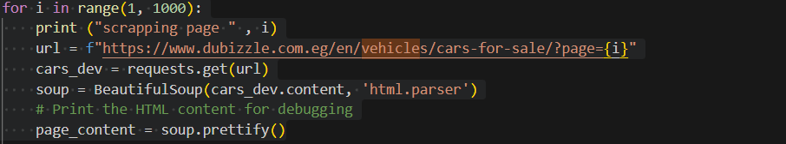
Web Scraping
Used script on Github/Kaggle for hatl2ee scraping
Used its base to scrap other sites
Parse the page_content (html syntax) to get the cars information
Html content/format is different from site to another
Make sure that there’s no repeated chunks (accurate #max_pages is defined)
It was bug in the github code

Slide 12
Scraping vs Kaggle (clean data)
 | Kaggle | Scraping
Hatla2ee | 20787 | 21748
OLX | - | 7449
Yallamotors | 2987 | -
Total | 23774 | 29197
Scraping is better!

Slide 13
Agenda
Used cars market in Egypt
Project Objectives
Dataset
Approach
Data Preprocessing
Data Visualization
Regression Models
Evaluation
Score Improvements
Comparison with Literature Review

Slide 14
Approach
Data Source
Pre-Processing
Visualization (Data Exploration)
Regression Models
Evaluation

Slide 15
Agenda
Used cars market in Egypt
Project Objectives
Dataset
Approach
Data Preprocessing
Data Visualization
Regression Models
Evaluation
Score Improvements
Comparison with Literature Review

Slide 16
Preprocessing
Data Loading
Imported required libraries (pandas, numpy).
Loaded datasets from Hatla2ee and OLX CSV files.
Displayed the first few rows (.head()) to inspect data. & Checked dataset information (.info()).
**Hatla2ee**
23163 Cars , 13 Features : Name , Price , Color , Mileage ,Make , Model , City , Date Displayed , Automatic Transmission , Air Conditioner , Power Steering , Remote Control , Item URL
There's missing values in Price , Mileage columns
All columns are objects
**OLX**
8756 Cars , 7 Features : Make , Model , Year , Price , Kilometers , Transmission , Fuel
There's no missing values
Make , Model , Transmission , Fuel are objects
Year , Price , Kilometers are integer

Slide 17
Preprocessing
Handling Duplicates (Source : Ads cars)
Counted duplicate rows using .duplicated().sum().
Removed duplicates with .drop_duplicates().
Rechecked for duplicates to confirm removal.
Dropped 231 duplicate rows from hatla2ee_data
current cars number is 22932
Dropped 1307 duplicate rows from olx_data
current cars number is 7449

Slide 18
Preprocessing
Handling Missing Values
Checked for missing values using .isnull().sum().
Dropped rows with missing values in essential columns only:
Name, Price, Mileage, Make, Model
Verified missing values again.
Source | Before | After
Hatl2ee | Name 0 Price 42 Color 0 Mileage 1069 Make 0 Model 0 City 0 Date Displayed 0 Automatic Transmission 0 Air Conditioner 0 Power Steering 0 Remote Control 0 Item URL 0 | Name 0 Price 0 Color 0 Mileage 0 Make 0 Model 0 City 0 Date Displayed 0 Automatic Transmission 0 Air Conditioner 0 Power Steering 0 Remote Control 0 Item URL 0
OLX | Make 0 Model 0 Year 0 Price 0 Transmission 0 Kilometers 0 Fuel 0

Slide 19
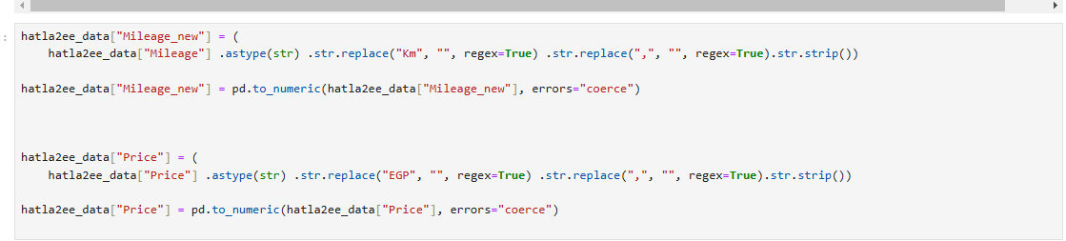
Preprocessing
Fix Column Values
Hatla2ee [“Price”] & [“Mileage”] need to be fixed as integer by removing EGP or km respectively
Old values :
price : 2,775,000 EGP , Mileage : 50,000 Km
New values :
price : 2775000 , Mileage : 50000

Slide 20
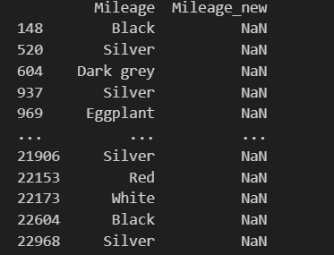
Preprocessing
Fix Column Values
Drop rows with null values in new columns : new Mileage (Wrong Original Values)

Slide 21
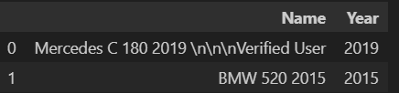

Preprocessing
Feature Engineering
Creating hatla2ee_data['Year'] by parsing the 'Name' column and getting the number which is 4
digits and starting with 20 or 19
Drop rows with null values in new columns: Year (Wrong Original Values)

Slide 22
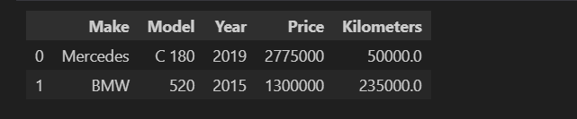
Aggregation
Combining Datasets
After renaming the columns to have matching headers, we merged Hatla2ee and OLX datasets to create a unified dataset.
Used pd.concat() to combine them to add the data without complex join conditions.

Slide 23
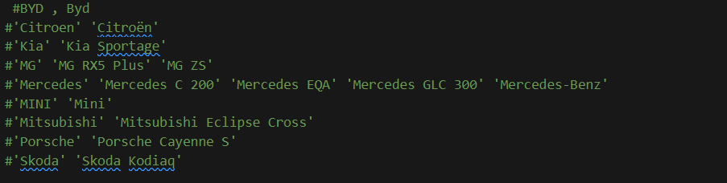
Aggregation
Unify the type of input in the “Make & Model”
Sorting the entries & getting the unique values to guarantee there is no entry that has the same
meaning in a different typing form like (BYD & Byd). And, this could be achieved by extracting
names manually, then code to strip data from any spaces or commas. (Special Characters ) and convert all to lower case
 | #Unique values (Before) | #Unique values (After) | Gain
Make | 117 | 103 | 14
Model | 1011 | 924 | 87

Slide 24
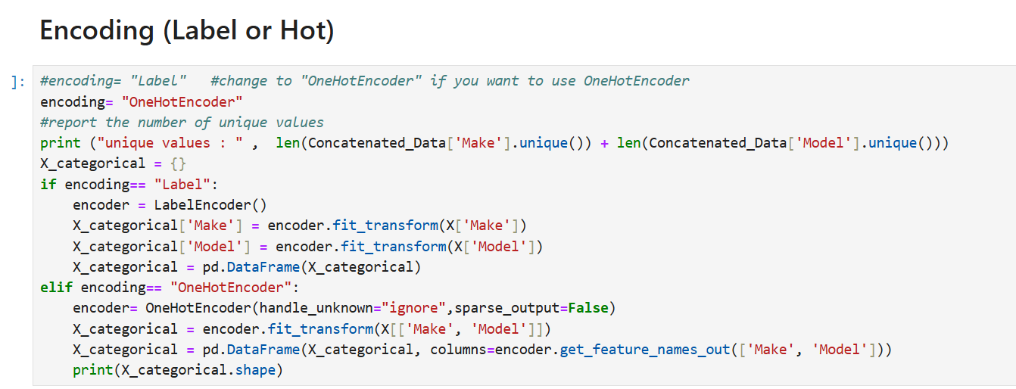
Encoding (Categorical Variable Encoding)
Machine learning models cannot process categorical data directly, so encoding is used to convert them into numerical values. The common encoding techniques are:
The two common types of scaling are:
Label Encoding: Assigns a unique number to each category. This is useful for ordinal data but may introduce bias in nominal categories.
One-Hot Encoding: Creates separate binary columns for each category. This is useful for nominal categorical variables but increases dimensionality.

Slide 25
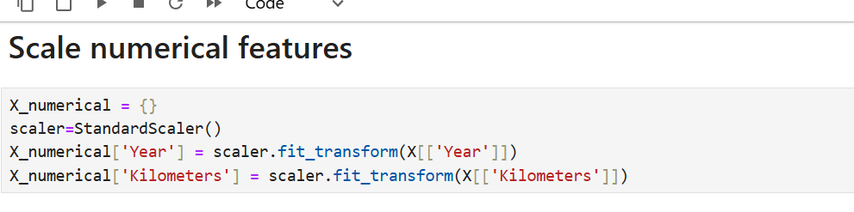
Feature Scaling
Technique used in data preprocessing to normalize or standardize numerical features so they are on a similar scale. This helps improve the performance of machine learning Models.
The two common types of scaling are:
Standardization
Normalization
In the notebook, numerical features are scaled using StandardScaler

Slide 26
Agenda
Used cars market in Egypt
Project Objectives
Dataset
Approach
Data Preprocessing
Data Visualization
Regression Models
Evaluation
Score Improvements
Comparison with Literature Review

Slide 27
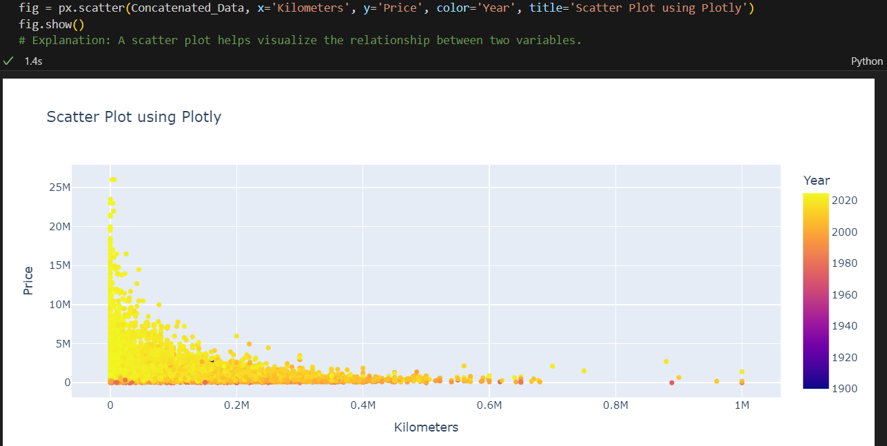
Data Visualization

Slide 28
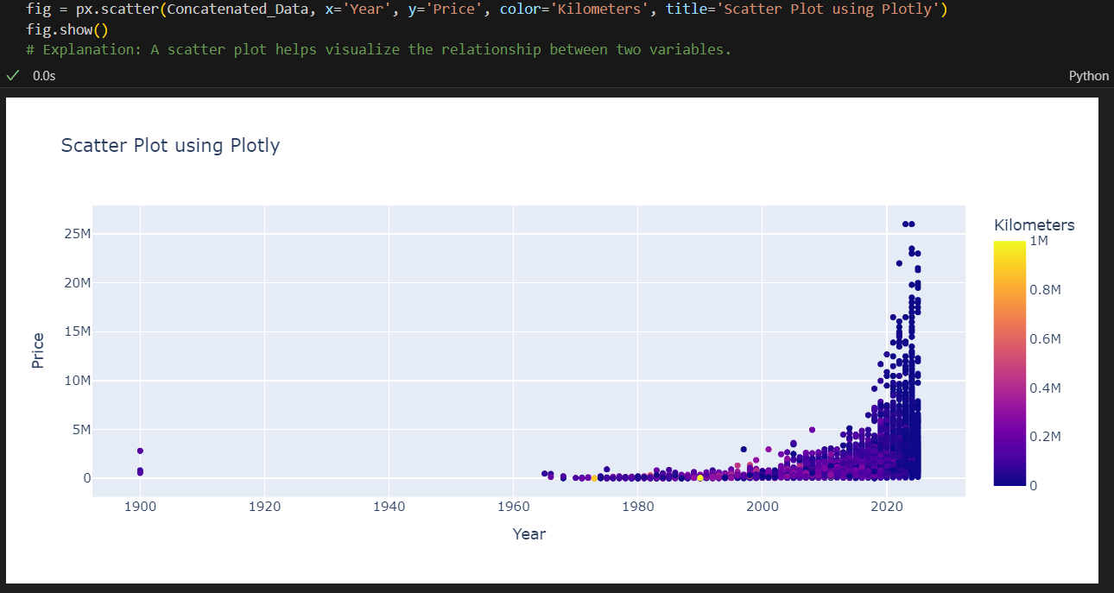
Data Visualization

Slide 29
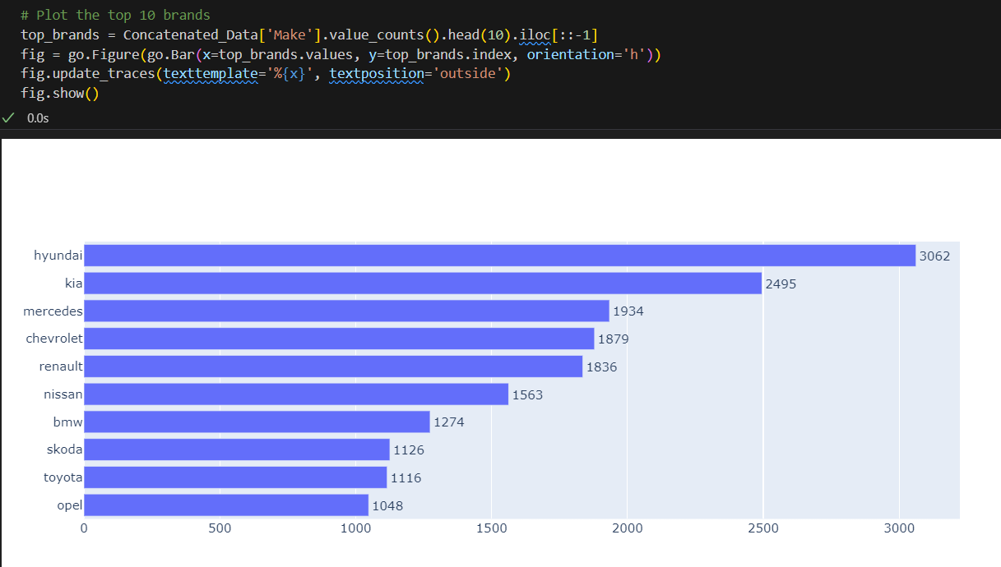
Data Visualization

Slide 30
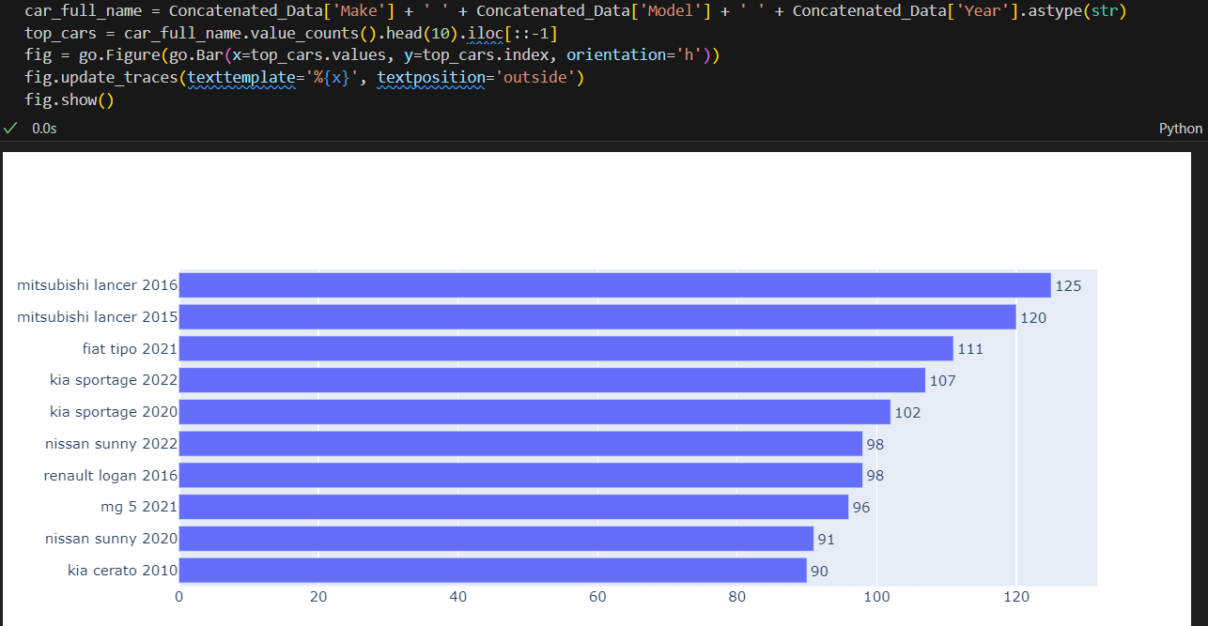
Data Visualization

Slide 31
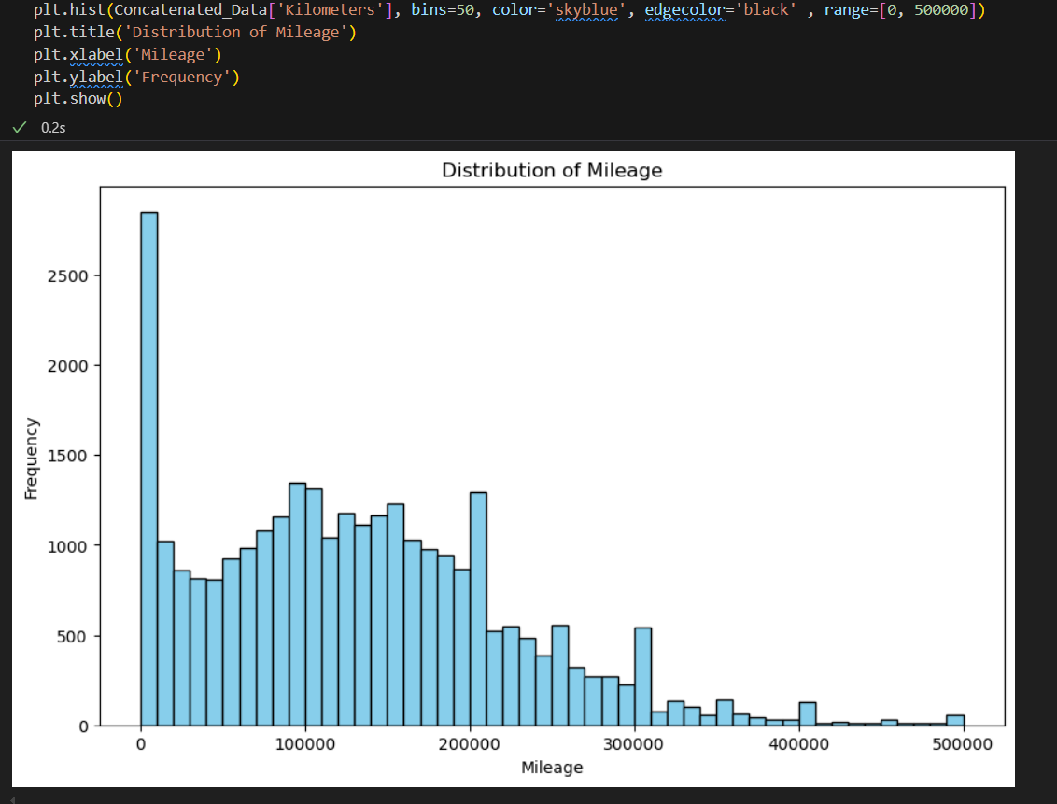
Data Visualization

Slide 32
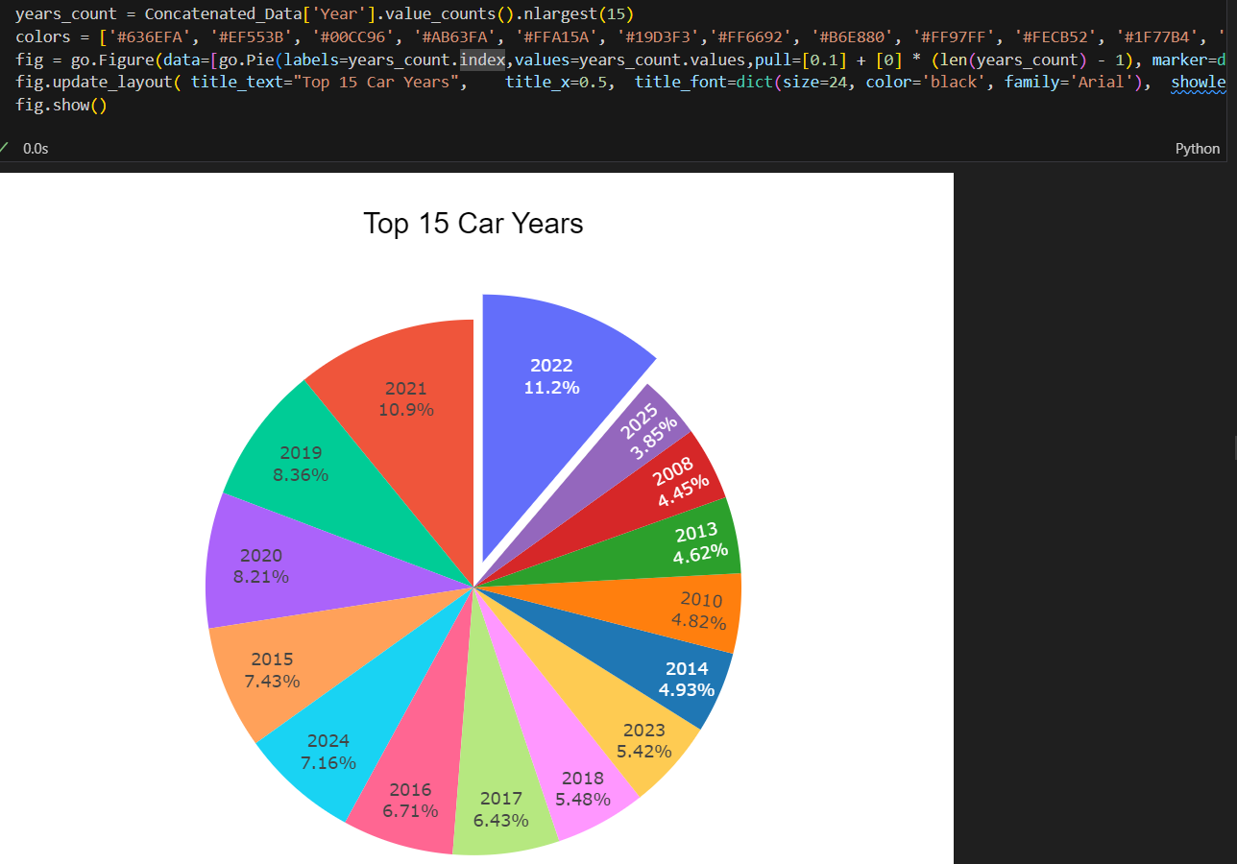
Data Visualization

Slide 33
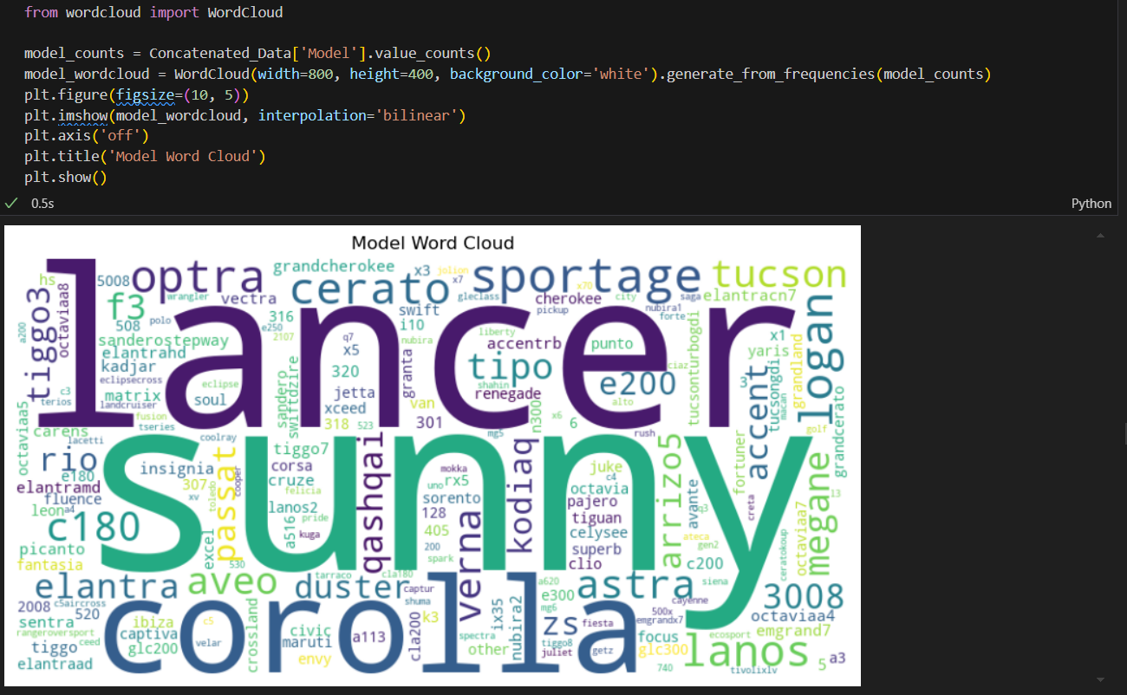
Data Visualization

Slide 34
Agenda
Used cars market in Egypt
Project Objectives
Dataset
Approach
Data Preprocessing
Data Visualization
Regression Models
Evaluation
Score Improvements
Comparison with Literature Review

Slide 35
Regression Models
Linear Regression:
finds the best-fitting line
minimizing the sum of squared errors.
Pros
Basic regression model
Model interpretability
Cons
Highly sensitive to outliers and multicollinearity.
How to Solve
Shrinkage
Ridge
Lasso

Slide 36
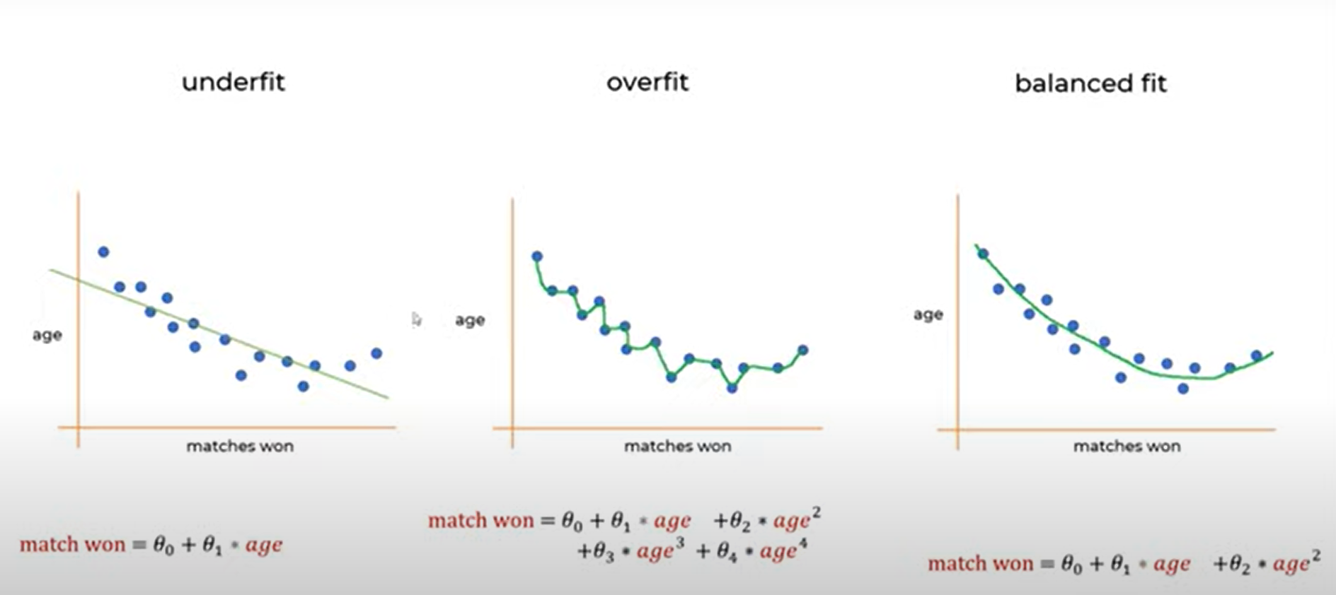
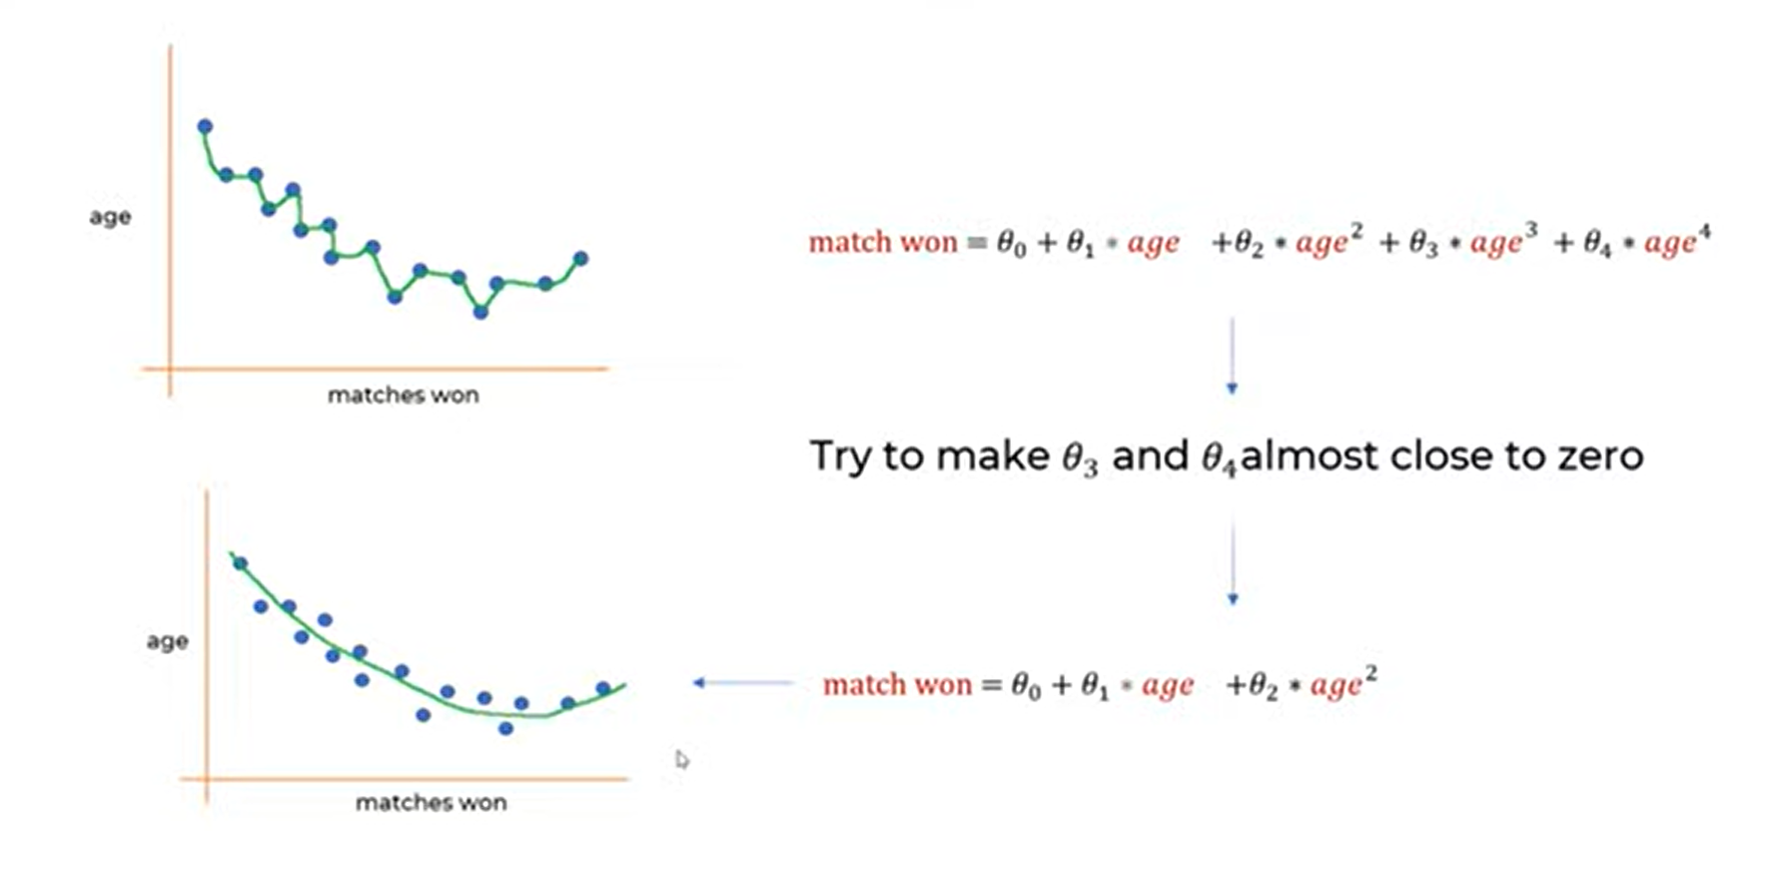
Regression Models

Slide 37
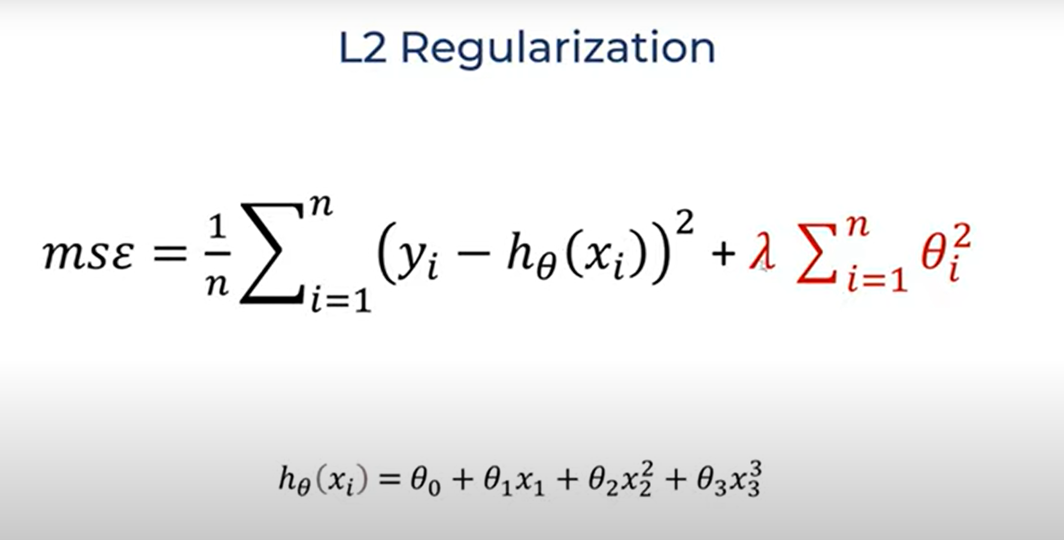
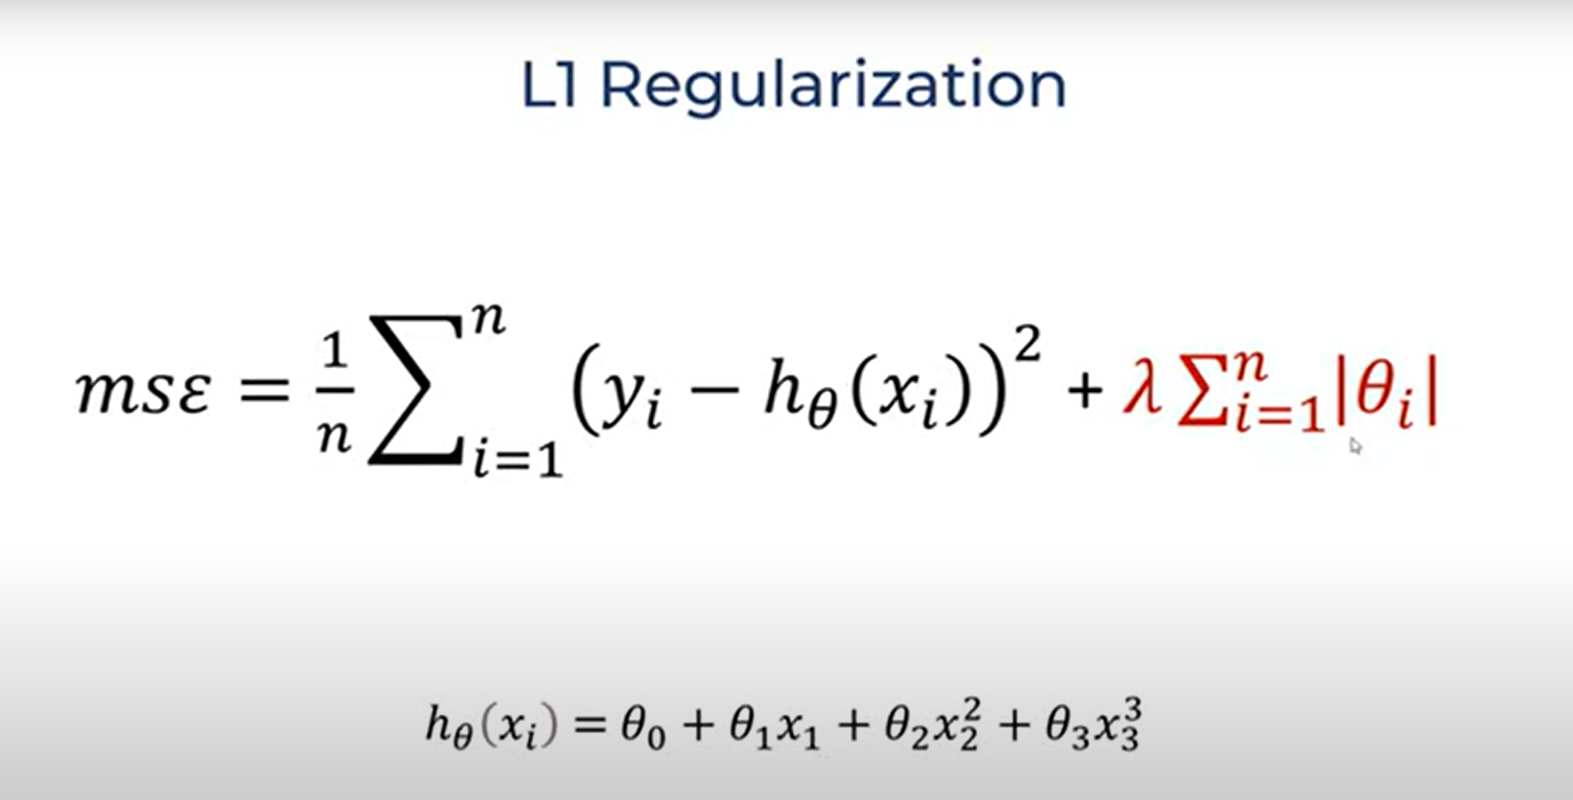
Regression Models
Ridge Regression
Lasso Regression
adds a penalty for large coefficients.
Helps reduce overfitting but does not shrink coefficients to zero.
Useful when predictors are highly correlated.
can shrink some coefficients to zero (feature selection).
Useful when you want a sparse model by eliminating unimportant variables

Slide 38
Regression Models
Random Forest Regression
Ensemble of decision trees that learns patterns by averaging multiple tree predictions.
Pros
Handles non-linearity well
robust to outliers
less sensitive to multicollinearity.
Efficient on large datasets
Cons
Not interpretable like linear models.
Expensive computation

Slide 39
Agenda
Used cars market in Egypt
Project Objectives
Dataset
Approach
Data Preprocessing
Data Visualization
Regression Models
Evaluation
Score Improvements
Comparison with Literature Review

Slide 40
Regression Results
Regression Model | Encoing Type | Evaluation Metrics
 |  | R2 | Mae | Rmse
Random Forest | LabelEncoding | 0.8947 | 141289.33 | 407473.18
 | OneHotEncoding | 0.8383 | 137562.64 | 504912.03
Linear Regression | LabelEncoding | 0.2266 | 637971.91 | 1104084.86
 | OneHotEncoding | NA | NA | NA
Ridge Regression | LabelEncoding | 0.2266 | 637968.02 | 1104084.36
 | OneHotEncoding | 0.7778 | 253241.07 | 591849.93
Lasso Regression | LabelEncoding | 0.2266 | 637971.75 | 1104084.84
 | OneHotEncoding | 0.7655 | 252897.63 | 607930.70

Slide 41
Regression Conclusion
Regression Model | Encoing Type | Explanation
Random Forest | LabelEncoding | Random forest is better accuracy and label encoder is more applicable for it
 | OneHotEncoding
Linear Regression | LabelEncoding | Linear Regression not applicable for onehot encoder due to the large number of features
 | OneHotEncoding
Ridge Regression | LabelEncoding | Results for one hot encoder is better than label encoder for Ridge/Lasso due to the large number of Make/Model
 | OneHotEncoding | Results for one hot encoder is better than label encoder for Ridge/Lasso due to the large number of Make/Model
Lasso Regression | LabelEncoding
 | OneHotEncoding

Slide 42
Agenda
Used cars market in Egypt
Project Objectives
Dataset
Approach
Data Preprocessing
Data Visualization
Regression Models
Evaluation
Score Improvements
Comparison with Literature Review

Slide 43
Improvements Ideas : Bining for Kilometers
Idea : Bining kiometers by rounding to nearst 10000 to reduce the values variants
Impact
unique values : 1677 -> 70
No improvisent for the R-squared

Slide 44
Models Grid
Model | Variations
LinearRegression | fit_intercept: [True, False]
Ridge | alpha: [0.1, 1, 10] solver: ['auto', 'lsqr', 'cholesky']
DecisionTree | max_depth: [5, 10, 20] min_samples_split: [2, 10, 20]
RandomForest | n_estimators: [100, 500, 1000] max_features: ['sqrt', 'log2'] max_depth: [10, 20, 30]
ExtraTrees Regressor | n_estimators: [100, 500, 1000] max_depth: [10, 20, 30]
Bagging Regressor | n_estimators: [100, 400] max_samples: [0.5, 0.8, 1.0]
XGB Regressor | n_estimators: [200, 600] learning_rate: [0.01, 0.1] max_depth: [6, 10] subsample: [0.5, 0.8]
LGBM Regressor | n_estimators: [200, 600] learning_rate: [0.01, 0.1] num_leaves: [31, 50]

Slide 45
Models Grid
Model | Variations
CatBoost Regressor | iterations: [200, 500] depth: [6, 10] learning_rate: [0.01, 0.1] l2_leaf_reg: [3, 5]
AdaBoost Regressor | n_estimators: [200, 600] learning_rate: [0.001, 0.01] loss: ['linear', 'square', 'exponential']

Slide 46
Models Grid
ID | Model | Label Encoder |  | OneHot Encoder
ID | Model | R2 Score | Best Parameters | R2 Score | Best Parameters
0 | LinearRegression | 0.226615 | {'fit_intercept': True} | 0.226615 | {'fit_intercept': True}
1 | Ridge | 0.226622 | {'alpha': 10, 'solver': 'auto'} | 0.226622 | {'alpha': 10, 'solver': 'auto'}
2 | DecisionTree | 0.833749 | {'max_depth': 20, 'min_samples_split': 10} | 0.833749 | {'max_depth': 20, 'min_samples_split': 10}
3 | RandomForest | 0.872657 | {'max_depth': 30, 'max_features': 'sqrt', 'n_estimators': 500} | 0.872657 | {'max_depth': 30, 'max_features': 'sqrt', 'n_estimators': 500}
4 | ExtraTrees Regressor | 0.876101 | {'max_depth': 20, 'n_estimators': 1000} | 0.876101 | {'max_depth': 20, 'n_estimators': 1000}
5 | Bagging Regressor | 0.894741 | {'max_samples': 0.8, 'n_estimators': 400} | 0.894741 | {'max_samples': 0.8, 'n_estimators': 400}
6 | XGB Regressor | 0.885792 | {'learning_rate': 0.1, 'max_depth': 6, 'n_estimators': 200, 'subsample': 0.8} | 0.885792 | {'learning_rate': 0.1, 'max_depth': 6, 'n_estimators': 200, 'subsample': 0.8}
7 | LGBM Regressor | 0.876207 | {'learning_rate': 0.1, 'n_estimators': 600, 'num_leaves': 31} | 0.876207 | {'learning_rate': 0.1, 'n_estimators': 600, 'num_leaves': 31}
8 | CatBoost Regressor | 0.902307 | {'depth': 10, 'iterations': 500, 'l2_leaf_reg': 3, 'learning_rate': 0.1} | 0.902307 | {'depth': 10, 'iterations': 500, 'l2_leaf_reg': 3, 'learning_rate': 0.1}
9 | AdaBoost Regressor | 0.409944 | {'learning_rate': 0.01, 'loss': 'exponential', 'n_estimators': 200} | 0.409944 | {'learning_rate': 0.01, 'loss': 'exponential', 'n_estimators': 200}

Slide 47
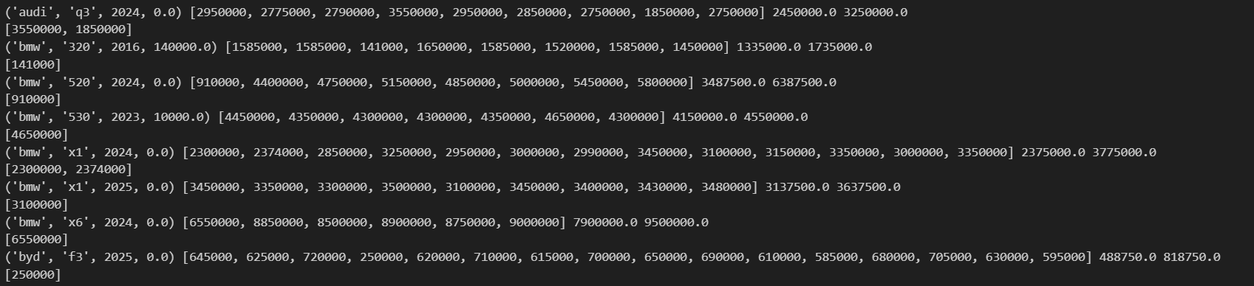
Improvements Ideas : Outliars Removal
Lower/upper boundaries should be calculated for specific car category
Approach
Bining for Kilometers values
create cars_dict with nested four keys : Make , Model , Year , KiloMeters and value is array of Price
calculate Q1, Q3 , IQR , LB , UB for each category
Detection for the outliars

Slide 48
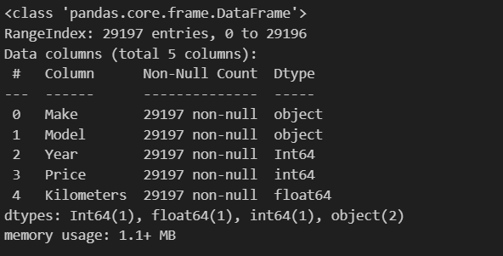
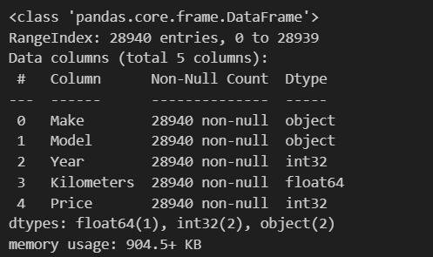
Improvements Ideas : Outliars Removal
create empty df cars_df_nooutliers with columns Make , Model , Year , KiloMeters , Price
Looping over dictionary and filling the DF with the values within the range
257 outliars have been removed

Slide 49
Regression Results
Regression Model | Encoing Type | Evaluation Metrics R2
 |  | Before outliars removal | After outliars removal
Random Forest | LabelEncoding | 0.8947 | 0.9046
 | OneHotEncoding | 0.8383 | 0.8684
Linear Regression | LabelEncoding | 0.2266 | 0.2186
 | OneHotEncoding | NA
Ridge Regression | LabelEncoding | 0.2266 | 0.2186
 | OneHotEncoding | 0.7778 | 0.8061
Lasso Regression | LabelEncoding | 0.2266 | 0.2186
 | OneHotEncoding | 0.7655 | 0.7735

Slide 50
Agenda
Used cars market in Egypt
Project Objectives
Dataset
Approach
Data Preprocessing
Data Visualization
Regression Models
Evaluation
Score Improvements
Comparison with Literature Review

Slide 51
Literature Review
https://www.kaggle.com/code/abdelrahmanahmed110/egyptian-used-cars-eda
https://www.kaggle.com/code/kamalelfar/eda-of-used-egyptian-cars
https://www.kaggle.com/code/mohamedhaithamyamani/egyptian-used-car-price-prediction
https://www.kaggle.com/code/abdelrhman690/analysis-and-predictions-of-used-cars-on-hatla2ee
https://www.kaggle.com/code/khalidmostafa/egypt-used-cars-eda-4-model-prediction
https://sites.google.com/pharma.asu.edu.eg/aya-selim/projects/egyptian-used-cars-price-prediction

Slide 52
Comparison with Literature Review
 | Our Model | 1 | 2 | 3 | 4 | 5 | 6
Dataset | Scraping Hatl2ee , OLX (30k cars) | Hatl2ee Kaggle dataset (20k cars) |  |  |  | 14k cars on Kaggle 3 years ago | scrap data on hatla2ee.com (20k cars)
Objective | Prediction | Data EDA without Prediction |  | Prediction
Selected Regression Model | Random Forest |  |  | RandomForest | XGB | Random Forest | NN
Prediction Results (R-squared) | 0.8947 |  |  | 0.87 | 0.758888 | 0.90739320 | 0.9

